Slide 1
Objective
Market Opportunity Assessment
Product Proposition Analysis & Competitive Analysis
Value Proposition
Go-To-Market Strategy
Implementation Strategy
Financial Strategy
Agenda
AGENDA

Slide 2
Objective
Market Opportunity Assessment
Product Proposition Analysis & Competitive Analysis
Go-To-Market Strategy
Implementation Strategy
Financial Strategy
Agenda
Value Proposition
OBJECTIVE

Slide 3
Objective
Market Opportunity Assessment
Product Proposition Analysis & Competitive Analysis
Go-To-Market Strategy
Implementation Strategy
Financial Strategy
Agenda
Value Proposition
MARKET OPPORTUNITY ASSESSMENT

Slide 4
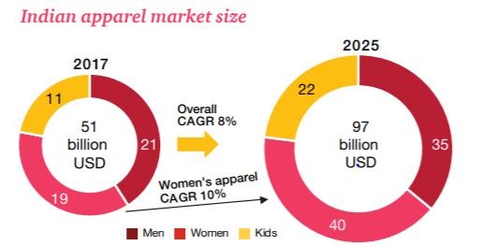
Objective
Market Opportunity Assessment
Product Proposition Analysis & Competitive Analysis
Go-To-Market Strategy
Implementation Strategy
Financial Strategy
Agenda
Value Proposition
450 million internet user base, grow by 62 percent to 729 million by 2020; 310 million access internet at least once a month, expected to increase by 35 percent to 419 million by 2020.
Total number of online transactions were 200 million in 2017 and are expected to increase by 65 percent by 2020. Of the online transactions, 60 million is the base of online fashion shoppers, which is estimated to double by 2020 to about 120 million.
Out of the online shoppers, women shoppers form a base of 45 percent
E-commerce is a key channel for fashion and the online fashion market is projected to grow 3.5 fold from to reach USD 14 billion by 2020.
Apparel e-retailing space has attracted investments worth $70 million i.e. 40% of the total funding Indian e-retailers bagged during the period.
Currently, online fashion portals account for four to five per cent of the total fashion market, comparable to sales from department stores put together. The report says this will increase to 11-12 per cent by 2020
GROWTH DRIVERS
IT devices and communication solutions
Virtual Reality software
Multiple payment options
Last mile delivery
High disposable incomes
Increasing number of working women
Aspirational and impulse Buying
Globalisation
CHALLENGES TO GROWTH
Competitors
Poor Infrastructure
GST
Touch and feel products
High cost of capital

Slide 5
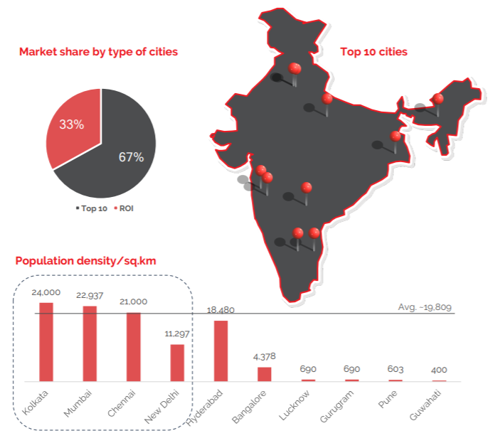
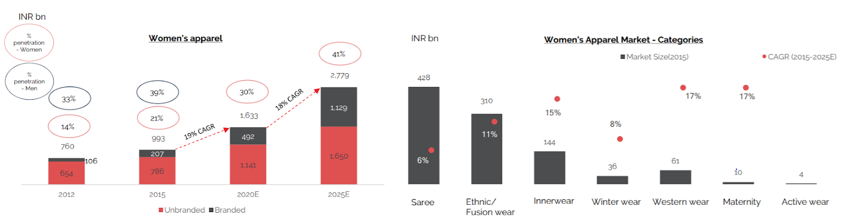
Objective
Market Opportunity Assessment
Product Proposition Analysis & Competitive Analysis
Go-To-Market Strategy
Implementation Strategy
Financial Strategy
Agenda
Value Proposition

Slide 6
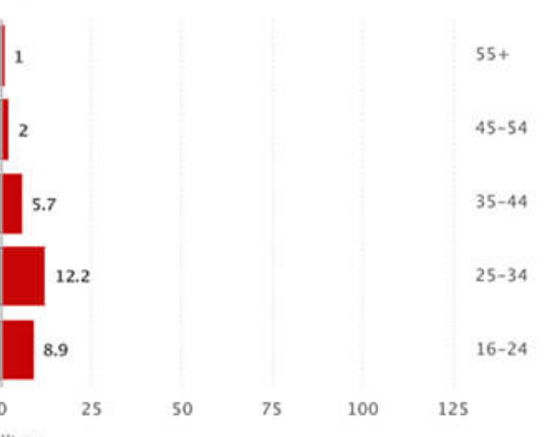
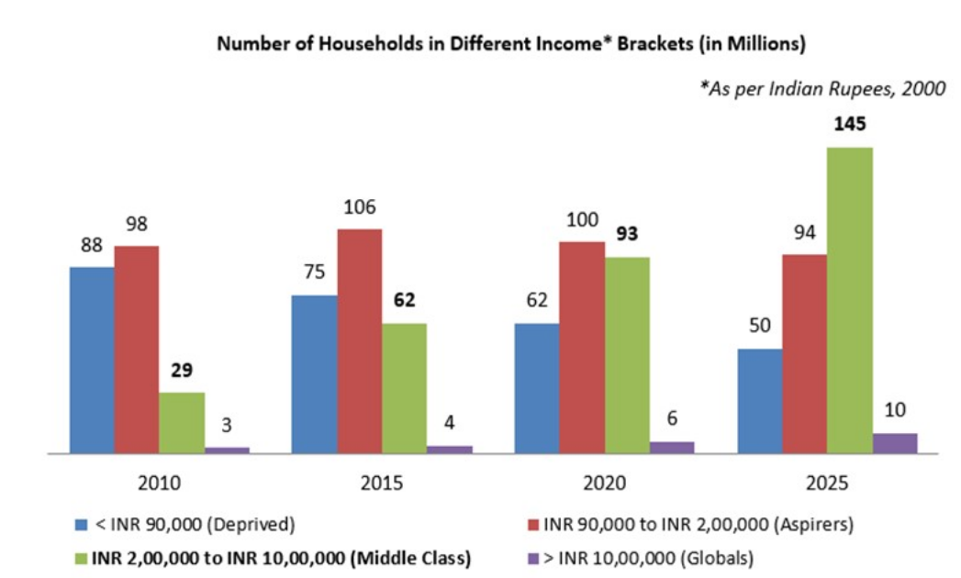
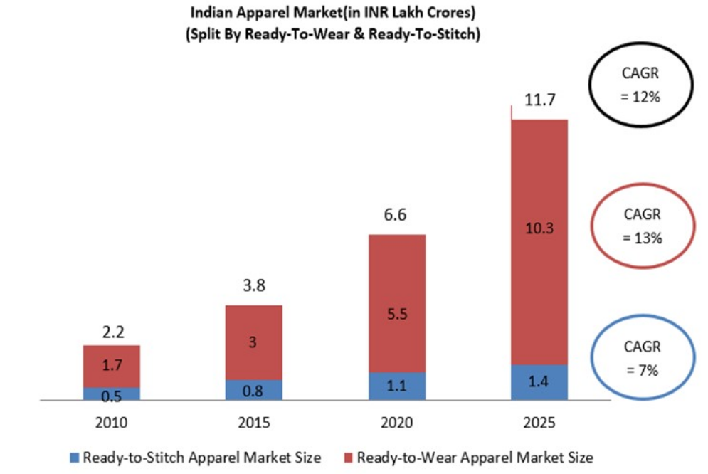
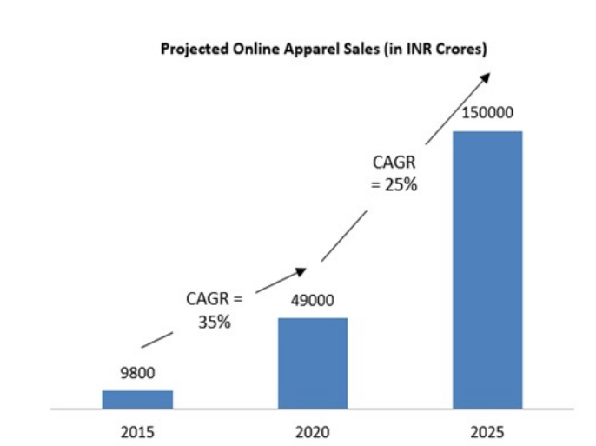
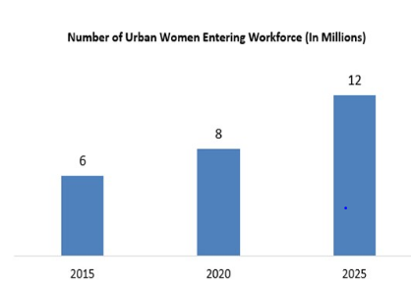
Objective
Market Opportunity Assessment
Product Proposition Analysis & Competitive Analysis
Go-To-Market Strategy
Implementation Strategy
Financial Strategy
Agenda
Value Proposition
USER BY AGE GROUP IN ECOMMERCE MARKET (IN MILLIONS)

Slide 7
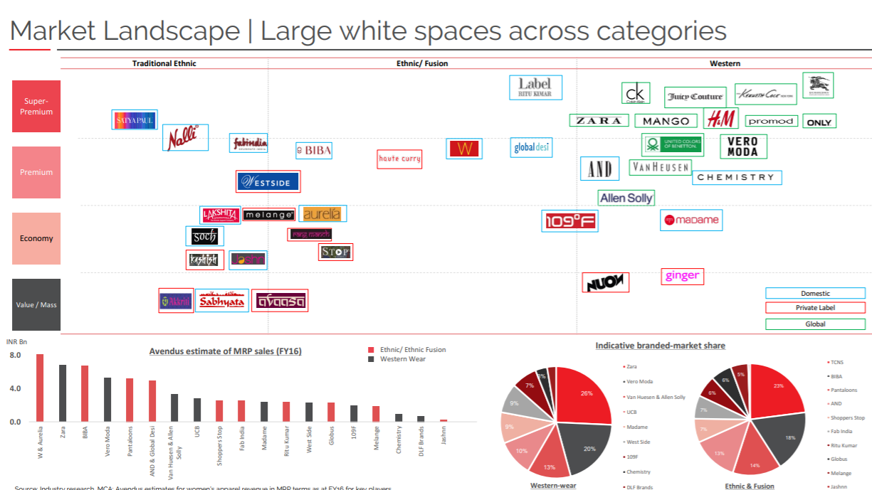
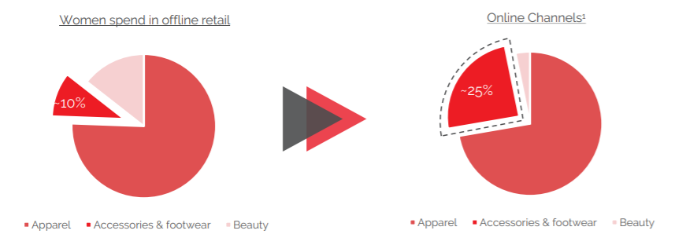
Objective
Market Opportunity Assessment
Product Proposition Analysis & Competitive Analysis
Go-To-Market Strategy
Implementation Strategy
Financial Strategy
Agenda
Value Proposition

Slide 8
Objective
Market Opportunity Assessment
Product Proposition Analysis & Competitive Analysis
Value Proposition
Go-To-Market Strategy
Implementation Strategy
Financial Strategy
Agenda
VALUE PROPOSITION

Slide 9

Objective
Market Opportunity Assessment
Product Proposition Analysis & Competitive Analysis
Value Proposition
Go-To-Market Strategy
Implementation Strategy
Financial Strategy
Agenda
CUSTOMER SEGMENTS
18 - 45 years age group women, both in Metro’s and Tier I & Tier II Cities
Demographics include college going, working professional, married , single women.
Parameters
Tier I and 2
Cities driving growth
Market Share of the top cities to decline from 45% to 30% in the next 7-10 years as compared to the other tier 1 & 2 cities.
Shift
In women’s buying behaviour
Impulsive buying, artificial obsolescence- key factor causing a shift in buying behaviour
Association of brand now more with design language, 25% of people consider style/design as no.1 consideration
influenced by retailer brand, suggestions and promotions
Relationship seekers
Casual Buyers
Convenience seekers
Seeks value in convenience, ordering, delivery, maintaining long relationships
Not concerned with perishables or delivery time windows
Influencers
Who want to build a self brand and be a influencer

Slide 10
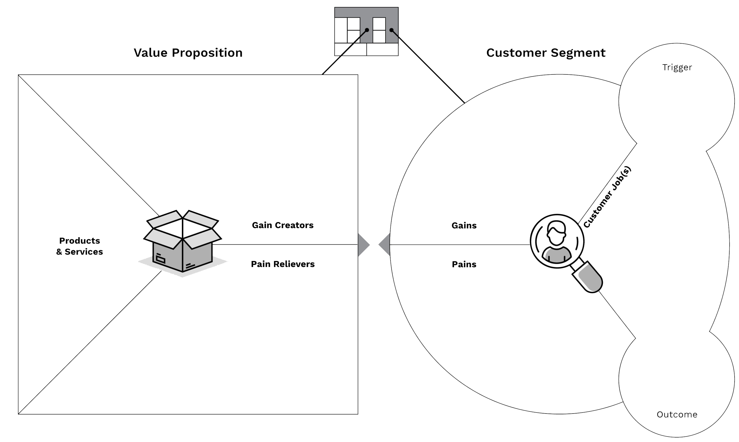
Objective
Market Opportunity Assessment
Product Proposition Analysis & Competitive Analysis
Value Proposition
Go-To-Market Strategy
Implementation Strategy
Financial Strategy
Agenda
Shape personalities
Quick latest design launches
Reduction in cost and time
Access to celebrity designs
Access to larger audience
Clothes look impressive, Comfort Fit, Designer and premium looks
Good quality materials used, reputable brand, latest celebrity ethnic designs available quickly, helps make a profitable portfolio
VALUE
PROPOSITION
Indian ethnic wear
Indo – western apparels
Designer and trendy designers
Quick churning of designs
Outsourcing of Manufacturing resulting into low cost
After sales services
Deep distribution network
Regular online content
Website/Application
Social media Brand Community and influence
How the products offered create customer gains
Make quick decisions to get to work on time
Stay trendy and up to date
Impress their audience
Stay true to the culture but still be modern
Good quality at low prices
Promote self brand
Outcomes or benefits that our customers want, expect or desire
List of what we offer our customers
both tangible & intangible
Things our customers are trying to get done in their work or in their life
Things that annoys or prevent our customers from getting their job done
How the products offered alleviate specific customer pains
CANVAS
Affordable prices & Trendy designs
Good quality, low prices
Elevate confidence
Quick delivery and frequent design launches
Increase in income for influencers
Lack of time to make choices
Good designs at high cost
No affordable designer options in affordable pricing
Limited access to audience

Slide 11
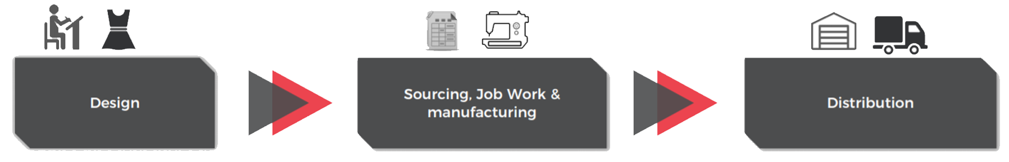
Objective
Market Opportunity Assessment
Product Proposition Analysis & Competitive Analysis
Value Proposition
Go-To-Market Strategy
Implementation Strategy
Financial Strategy
Agenda
VALUE PROPOSITION
“Provide on-trend Ethnic, Indo-western styles catering to women of all ages , that won’t break the bank. We believe that everyone can enjoy the beauty of fashion. And be their own fashion icon. It aims to promptly offer stylish quality products at appealing prices to every user.”
Inhouse Integrated design team
Completely outsourced to integrated mills
E-Commerce
“Our Customers’ outward image reflects the confidence they feel inside. They are sophisticated, fashion forward and in control of their own destiny. Every member of our family is one of a kind.”
Design
In-House team
Control & Flexibility to create designs
Feedback loop; integrated function
High Control as “Brand”/ “Design”
“Our designers are world class and best in their crafts. Each designer is unique to the family in providing designs for clothes which are extension of your personalities.”
FITMENT WITH BUSINESS MODEL

Slide 12
Go-To-Market Strategy
Objective
Market Opportunity Assessment
Product Proposition Analysis & Competitive Analysis
Value Proposition
Go-To-Market Strategy
Implementation Strategy
Financial Strategy
Agenda
GO-TO-MARKET STRATEGY

Slide 13



Objective
Market Opportunity Assessment
Product Proposition Analysis & Competitive Analysis
Value Proposition
Go-To-Market Strategy
Implementation Strategy
Financial Strategy
Agenda
Fusion of Indian and Western
Examples include Straight Pants, gowns, dresses
POSITIONING – Comfort And Style
WHAT?
Online, Direct Selling
Through Website and Social Media Commerce (Instagram and Facebook Store)
Distribution through third party Logistics Partners
Channel Partnership with Payment Gateways
GTM STRATEGY
Target: 18-45 age group
Approximately 25% of population
College going, working professional
Media habits: 2-3 hours spent on social media platforms
Looking for new trends and cultures
HOW?
WHO?

Slide 14


Objective
Market Opportunity Assessment
Product Proposition Analysis & Competitive Analysis
Value Proposition
Go-To-Market Strategy
Implementation Strategy
Financial Strategy
Agenda
CHANNEL STRATEGY
PROMOTIONS
MANUFACFTURING UNIT
Building Brand Community on Facebook, and providing discounts to Sign Ups through Facebook through photo sharing and story telling, #MyStyle
Collaborating with Influencers on Instagram to provide style guides and offers on sign ups
Instagram Giveaways to get traction on Insta handle
Creating an Influencers programme where consumers and Influencers collaborate to contribute towards design ideas
SEO, Affiliate Marketing and Remarketing.
ECOM EXPRESS FULFILLMENT CENTERS
50%
LAST MILE DELIVERY
WHY ECOM EXPRESS?
Around 22 fulfilment centers across India
2400+ cities and 25000+ pincodes
First Mile Pick Ups
Last mile delivery of the majority of orders anywhere in India within 24 to 72 hours, every day for 365 days a year - including Sundays/Holidays
Prepaid, COD and Digital payment Solutions
Branding Services
Try & Buy, Reverse Logistics and Switch Deliveries
A flat rate based on weight, volume and distance. Besides, there is a rent for storage, and an extra fee in cases where cash-on-delivery is involved

Slide 15
Go-To-Market Strategy
Objective
Market Opportunity Assessment
Product Proposition Analysis & Competitive Analysis
Value Proposition
Go-To-Market Strategy
Implementation Strategy
Financial Strategy
Agenda
FINANCIAL STRATEGY

Slide 16
Go-To-Market Strategy
Objective
Market Opportunity Assessment
Product Proposition Analysis & Competitive Analysis
Value Proposition
Go-To-Market Strategy
Implementation Strategy
Financial Strategy
Agenda
FINANCIAL VIABILITY
Financial statement contains projections of future years to access the health of the company and it is based on assumptions.
There is a steady increase in the Profit which says that there is scope for profits in future
Based in the valuation and investor risk appetite, we can suggest whether to invest in this project or not.

Slide 17
Go-To-Market Strategy
Objective
Market Opportunity Assessment
Product Proposition Analysis & Competitive Analysis
Value Proposition
Go-To-Market Strategy
Implementation Strategy
Financial Strategy
Agenda
IMPLEMENTATION STRATEGY

Slide 18
IMPLEMENTATION ROADMAP
Objective
Market Opportunity Assessment
Product Proposition Analysis & Competitive Analysis
Value Proposition
Go-To-Market Strategy
Implementation Strategy
Financial Strategy
Agenda
Quarter 1: Registration and Infrastructure Setup Begins
Quarter 2: Continued
Quarter 3:
Infrastructure in place
Sample production for Internal quality testing (Pushing out tested samples in the market)
Quarter 4:
Lead Generation
By the end of quarter, approvals in place, processes settled, final production begins (Gestation Period ends)
Capturing 1% of the total potential market
Identifying partners for developing distribution network
Achieving 20% growth in capacity utilization
Year 3 to Year 5
20% Year on year increase in capacity utilization
A very conservative sales growth target rate of 10% year on year
By the end of 5th year we would like to have achieved at least 10% market share in the Online Indo-Western Garment Segment.
Strengthening of distribution network
Year 1
Year 2
Year 3
Year 4
Year 5

Slide 19
Go-To-Market Strategy
THANK YOU

